Slide 1
4
Control Statements:
Part 1
Slides edited by Dr. Selim Aksoy

Slide 2
Let’s all move one place on.
  Lewis Carroll
The wheel is come full circle.
  William Shakespeare
How many apples fell on Newton’s head before he took the hint!
  Robert Frost
All the evolution we know of proceeds from the vague to the definite.
  Charles Sanders Peirce

Slide 3
OBJECTIVES
In this chapter you will learn:
Basic problem-solving techniques.
To develop algorithms through the process of top-down, stepwise refinement.
To use the if and if...else selection statements to choose among alternative actions.
To use the while repetition statement to execute statements in a program repeatedly.
Counter-controlled repetition and sentinel-controlled repetition.
To use the increment, decrement and assignment operators.

Slide 4
4.1 Introduction
4.2 Algorithms
4.3 Pseudocode
4.4 Control Structures
4.5 if Selection Statement
4.6 if...else Double-Selection Statement
4.7 while Repetition Statement
4.8 Formulating Algorithms: Counter-Controlled Repetition
4.9 Formulating Algorithms: Sentinel-Controlled Repetition
4.10 Formulating Algorithms: Nested Control Statements
4.11 Assignment Operators
4.12 Increment and Decrement Operators
4.13 (Optional) Software Engineering Case Study: Identifying Class Attributes in the ATM System
4.14 Wrap-Up

Slide 5
4.1 Introduction
Before writing a program
  Have a thorough understanding of problem
  Carefully plan your approach for solving it
While writing a program
  Know what “building blocks” are available
  Use good programming principles

Slide 6
4.2 Algorithms
Algorithms
  The actions to execute
  The order in which these actions execute
Program control
  Specifies the order in which actions execute in a program
  Performed in C++ with control statements

Slide 7
4.3 Pseudocode
Pseudocode
  Artificial, informal language used to develop algorithms
    Used to think out program before coding
      Easy to convert into C++ program
  Similar to everyday English
    Only executable statements
      No need to declare variables
  Not executed on computers

Slide 8
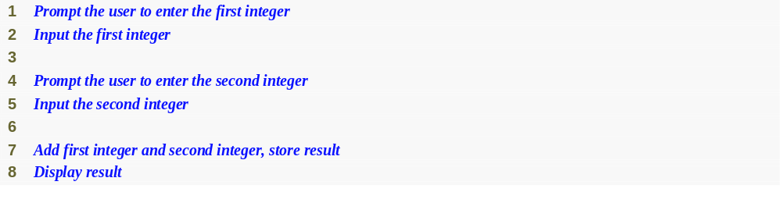
Fig. 4.1 | Pseudocode for the addition program of Fig. 2.5.

Slide 9
4.4 Control Structures
Sequential execution
  Statements executed in sequential order
Transfer of control
  Next statement executed is not the next one in sequence
Structured programming
  Eliminated goto statements

Slide 10
4.4 Control Structures (Cont.)
Only three control structures needed
  No goto statements
  Demonstrated by Böhm and Jacopini
  Three control structures
    Sequence structure
      Programs executed sequentially by default
    Selection structures
      if, if…else, switch
    Repetition structures
      while, do…while, for

Slide 11
4.4 Control Structures (Cont.)
Single-entry/single-exit control statements
  Three types of control statements
    Sequence statement
    Selection statements
    Repetition statements
  Combined in one of two ways
    Control statement stacking
      Connect exit point of one to entry point of the next
    Control statement nesting

Slide 12
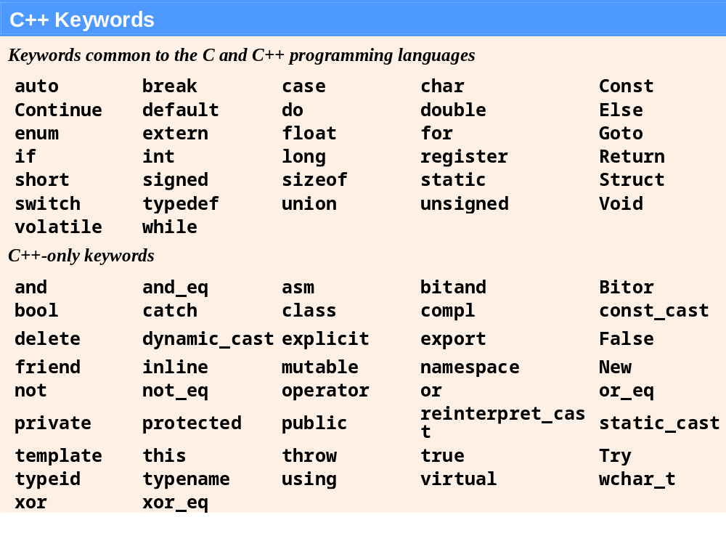
Fig. 4.3 | C++ keywords.

Slide 13
4.5 if Selection Statement
Selection statements
  Choose among alternative courses of action
  Pseudocode example
    If student’s grade is greater than or equal to 60
      Print “Passed”
      If the condition is true
        Print statement executes, program continues to next statement
      If the condition is false
        Print statement ignored, program continues
      Indenting makes programs easier to read
        C++ ignores white-space characters

Slide 14
4.5 if Selection Statement (Cont.)
Selection statements (Cont.)
  Translation into C++
    if ( grade >= 60 )
    cout << "Passed";
  Any expression can be used as the condition
    If it evaluates to false, it is treated as false
Diamond symbol in UML modeling
  Indicates decision is to be made
  Contains guard conditions
    Test condition
    Follow correct path

Slide 15
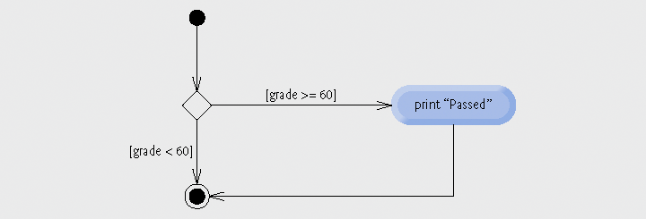
Fig. 4.4 | if single-selection statement activity diagram.

Slide 16
4.6 if…else Double-Selection Statement
if
  Performs action if condition true
if…else
  Performs one action if condition is true, a different action if it is false
Pseudocode
  If student’s grade is greater than or equal to 60
  print “Passed”
  Else
  print “Failed”
C++ code
  if ( grade >= 60 )
  cout << "Passed";
  else
  cout << "Failed";

Slide 17
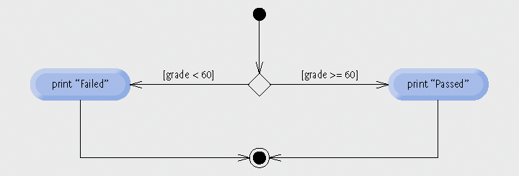
Fig. 4.5 | if...else double-selection statement activity diagram.

Slide 18
4.6 if…else Double-Selection Statement (Cont.)
Ternary conditional operator (?:)
  Three arguments (condition, value if true, value if false)
Code could be written:
  cout << ( grade >= 60 ? “Passed” : “Failed” );
Condition
Value if true
Value if false

Slide 19
4.6 if…else Double-Selection Statement (Cont.)
Nested if…else statements
  One inside another, test for multiple cases
  Once a condition met, other statements are skipped
  Example
    If student’s grade is greater than or equal to 90
  Print “A”
  Else
  If student’s grade is greater than or equal to 80
  Print “B”
  Else
  If student’s grade is greater than or equal to 70
  Print “C”
  Else
  If student’s grade is greater than or equal to 60
  Print “D”
  Else
    Print “F”

Slide 20
4.6 if…else Double-Selection Statement (Cont.)
Nested if…else statements (Cont.)
  Written In C++
    if ( studentGrade >= 90 )
    cout << "A";
    else
    if (studentGrade >= 80 )
    cout << "B";
    else
    if (studentGrade >= 70 )
    cout << "C";
    else
    if ( studentGrade >= 60 )
    cout << "D";
    else
    cout << "F";

Slide 21
4.6 if…else Double-Selection Statement (Cont.)
Nested if…else statements (Cont.)
  Written In C++ (indented differently)
    if ( studentGrade >= 90 )
    cout << "A";
    else if (studentGrade >= 80 )
    cout << "B";
    else if (studentGrade >= 70 )
    cout << "C";
    else if ( studentGrade >= 60 )
    cout << "D";
    else
    cout << "F";

Slide 22
4.6 if…else Double-Selection Statement (Cont.)
Dangling-else problem
  Compiler associates else with the immediately preceding if
  Example
    if ( x > 5 )
    if ( y > 5 )
    cout << "x and y are > 5";
    else
    cout << "x is <= 5";
  Compiler interprets as
    if ( x > 5 )
    if ( y > 5 )
    cout << "x and y are > 5";
    else
    cout << "x is <= 5";

Slide 23
4.6 if…else Double-Selection Statement (Cont.)
Dangling-else problem (Cont.)
  Rewrite with braces ({})
    if ( x > 5 )
    {
    if ( y > 5 )
    cout << "x and y are > 5";
    }
    else
    cout << "x is <= 5";
      Braces indicate that the second if statement is in the body of the first and the else is associated with the first if statement

Slide 24
4.6 if…else Double-Selection Statement (Cont.)
Compound statement
  Also called a block
    Set of statements within a pair of braces
    Used to include multiple statements in an if body
  Example
    if ( studentGrade >= 60 )
    cout << "Passed.\n";
    else
    {
    cout << "Failed.\n";
    cout << "You must take this course again.\n";
    }
  Without braces,
  cout << "You must take this course again.\n";
  always executes

Slide 25
4.6 if…else Double-Selection Statement (Cont.)
Empty statement
  A semicolon (;) where a statement would normally be
  Performs no action
  Also called a null statement

Slide 26
4.7 while Repetition Statement
Repetition statement
  Action repeated while some condition remains true
  Pseudocode
    While there are more items on my shopping list
    Purchase next item and cross it off my list
  while loop repeats until condition becomes false
  Example
    int product = 3;
    while ( product <= 100 )
    product = 3 * product;

Slide 27
4.8 Formulating Algorithms: Counter-Controlled Repetition
Problem statement
A class of ten students took a quiz. The grades (integers in the range 0 to 100) for this quiz are available to you. Calculate and display the total of
all student grades and the class average on the quiz.
Counter-controlled repetition
  Loop repeated until counter reaches certain value
  Also known as definite repetition
    Number of repetitions known beforehand

Slide 28
4.8 Formulating Algorithms: Counter-Controlled Repetition (Cont.)
Counter-controlled repetition (Cont.)
  Counter variable
    Used to count
      In example, indicates which of the 10 grades is being entered
  Total variable
    Used to accumulate the sum of several values
    Normally initialized to zero beforehand
      Otherwise it would include the previous value stored in that memory location

Slide 29
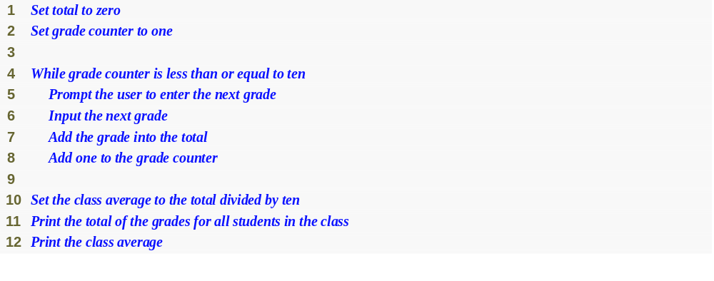
Fig. 4.7 | Pseudocode algorithm that uses counter-controlled repetition to solve the class average problem.

Slide 30
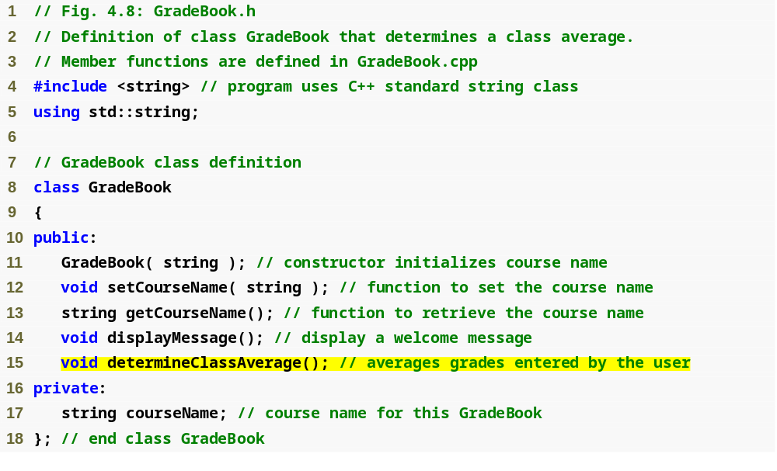
Outline
fig04_08.cpp
(1 of 1)
Function determineClassAverage implements the class average algorithm described by the pseudocode

Slide 31
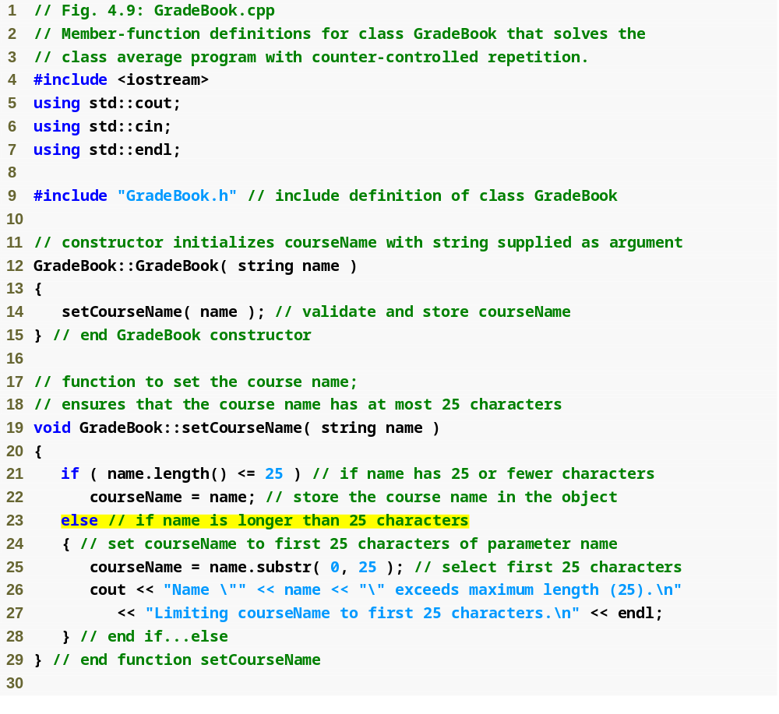
Outline
fig04_09.cpp
(1 of 3)
If course name was longer than 25, select first 25 characters

Slide 32
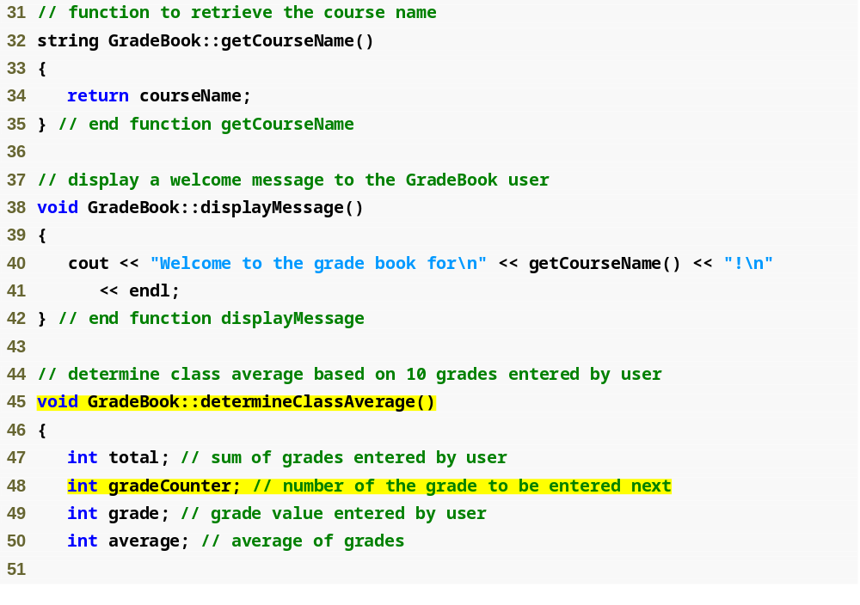
Outline
fig04_09.cpp
(2 of 3)
Function determineClassAverage implements the class average algorithm described by the pseudocode
Declare total variable total
Declare counter variable gradeCounter

Slide 33
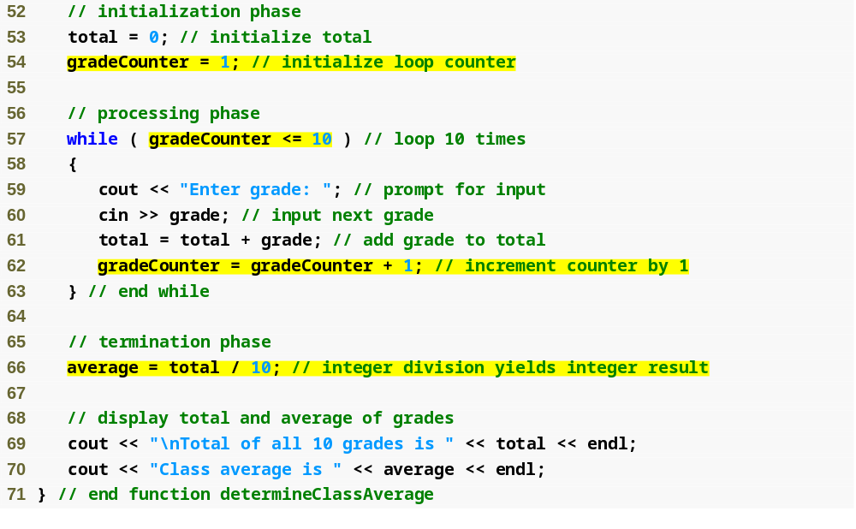
Initilize total variable total to 0
Outline
Initialize counter variable gradeCounter to 1
Continue looping as long as gradeCounter’s value is less than or equal to 10
fig04_09.cpp
(3 of 3)
Add the current grade to total
Increment counter by 1, which causes gradeCounter to exceed 10 eventually
Perform the averaging calculation and assign its result to the variable average

Slide 34
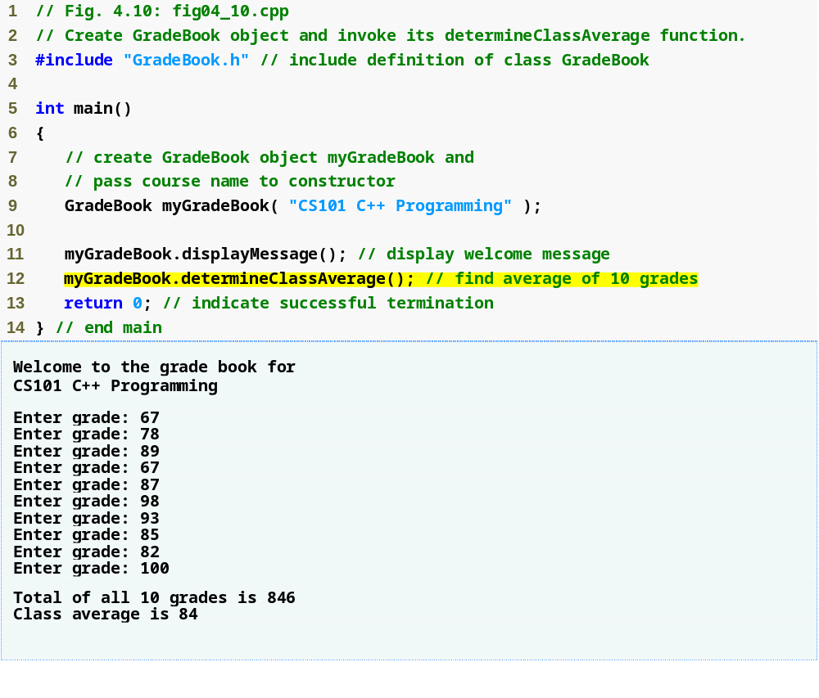
Outline
fig04_10.cpp
(1 of 1)

Slide 35
4.8 Formulating Algorithms: Counter-Controlled Repetition (Cont.)
Uninitialized variables
  Contain “garbage” (or undefined) values
Notes on integer division and truncation
  Integer division
    When dividing two integers
    Performs truncation
      Fractional part of the resulting quotient is lost

Slide 36
4.9 Formulating Algorithms: Sentinel-Controlled Repetition
Problem statement
Develop a class average program that processes grades
for an arbitrary number of students each time it is run.
Sentinel-controlled repetition
  Also known as indefinite repetition
  Use a sentinel value
    Indicates “end of data entry”
    A sentinel value cannot also be a valid input value
    Also known as a signal, dummy or flag value

Slide 37
4.9 Formulating Algorithms: Sentinel-Controlled Repetition (Cont.)
Top-down, stepwise refinement
  Development technique for well-structured programs
  Top step
    Single statement conveying overall function of the program
    Example
      Determine the class average for the quiz
  First refinement
    Multiple statements using only the sequence structure
    Example
      Initialize variables
      Input, sum and count the quiz grades
      Calculate and print the total of all student grades and the class average

Slide 38
4.9 Formulating Algorithms: Sentinel-Controlled Repetition (Cont.)
Top-down, stepwise refinement (Cont.)
  Second refinement
    Commit to specific variables
    Use specific control structures
    Example in Fig. 4.11
Fatal logic error
  Could cause the program the fail
    Often called “bombing” or “crashing”
  Division by zero is normally a fatal logic error

Slide 39
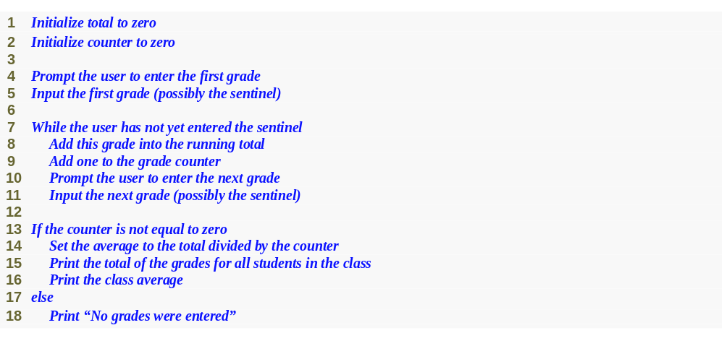
Fig. 4.11 | Class average problem pseudocode algorithm with sentinel-controlled repetition.

Slide 40
4.9 Formulating Algorithms: Sentinel-Controlled Repetition (Cont.)
Floating-point numbers
  A real number with a decimal point
  C++ provides data types float and double
    double numbers can have larger magnitude and finer detail
      Called precision
    Floating-point constant values are treated as double values by default
  Floating-point values are often only approximations

Slide 41

Outline
fig04_12.cpp
(1 of 1)

Slide 42
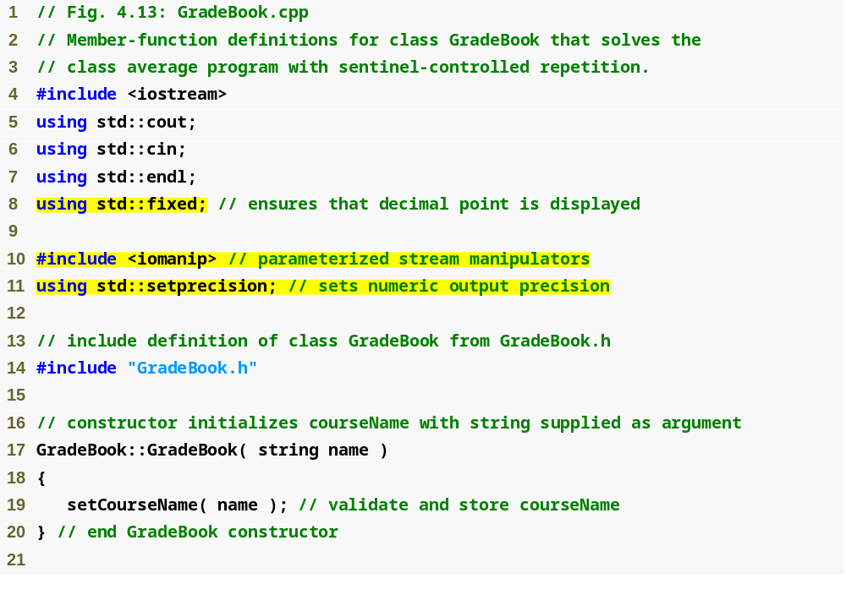
Outline
fixed forces output to print in fixed point format (not scientific notation) and forces trailing zeros and decimal point to print
fig04_13.cpp
(1 of 4)
steprecision stream manipulator (in header <iomanip>) sets numeric output precision

Slide 43
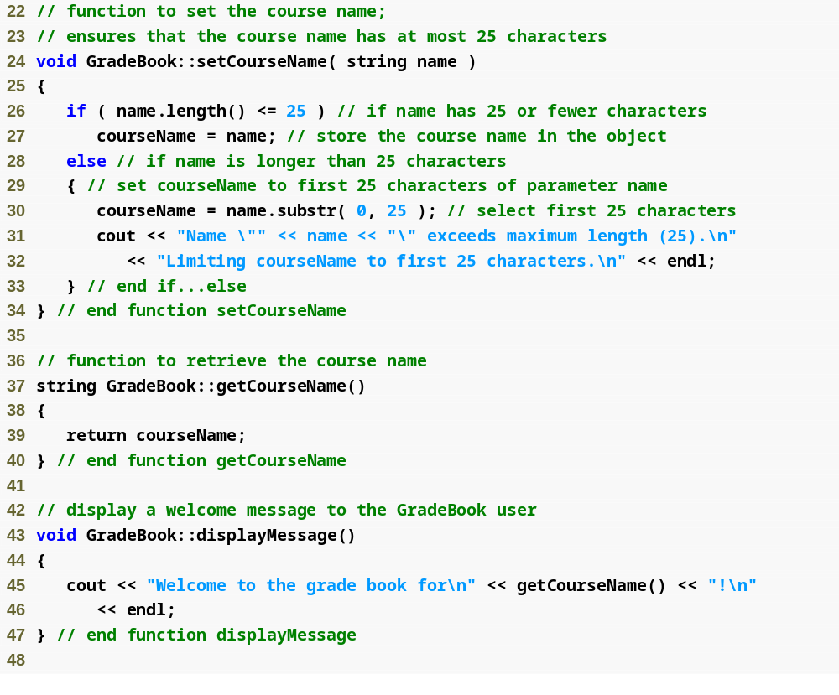
Outline
fig04_13.cpp
(2 of 4)

Slide 44
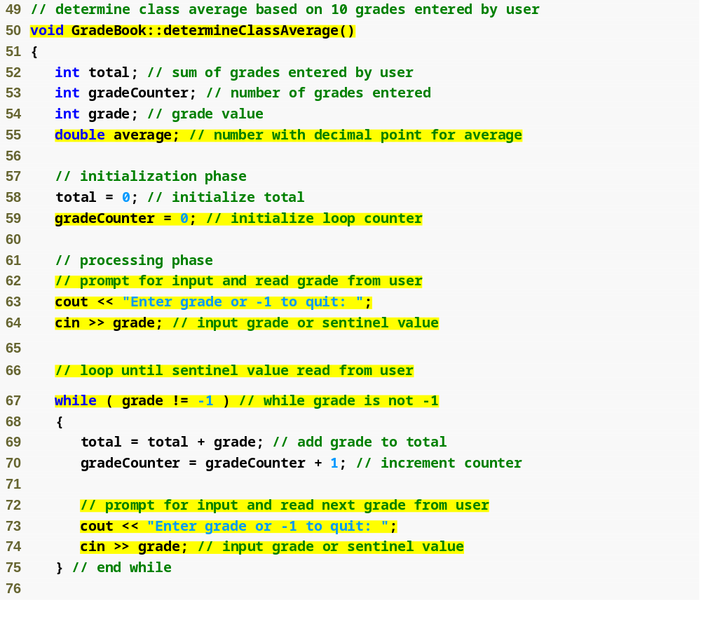
Outline
Function determineClassAverage implements the class average algorithm described by the pseudocode
fig04_13.cpp
(3 of 4)
Declare local int variables total, gradeCounter and grade and double variable average
while loop iterates as long as grade does not equal the sentinel value -1

Slide 45
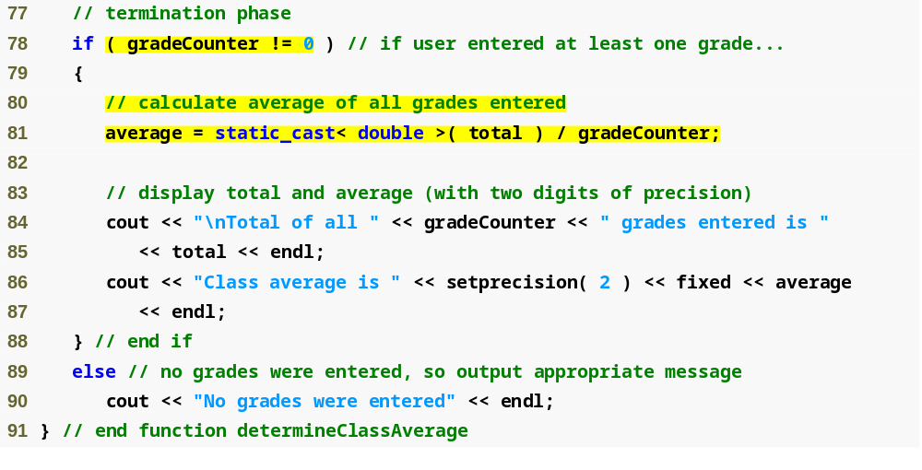
Outline
fig04_13.cpp
(4 of 4)
Calculate average grade using static_cast< double > to perform explicit conversion

Slide 46
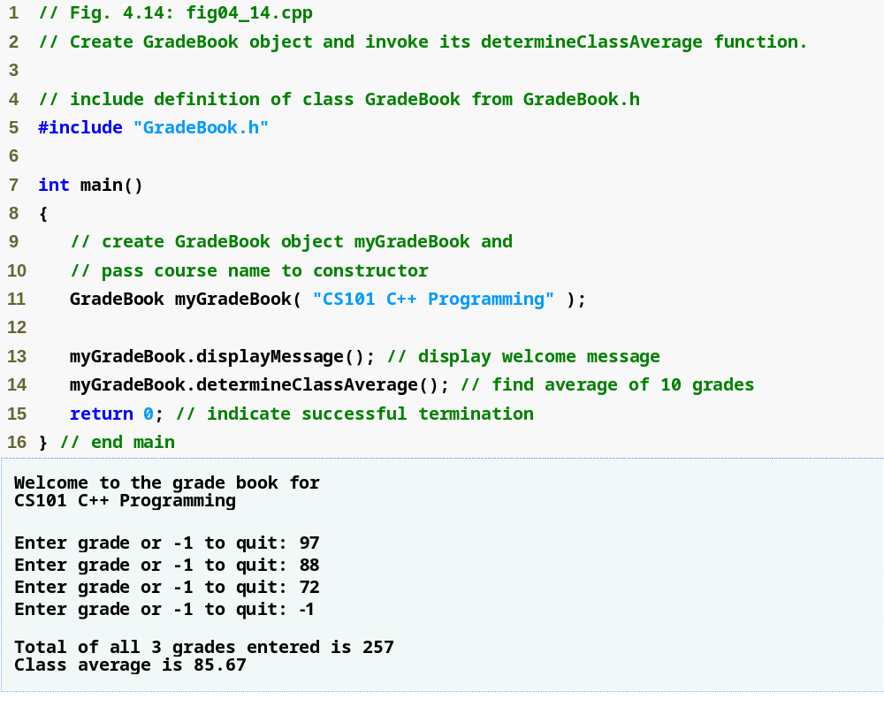
Outline
fig04_14.cpp
(1 of 1)

Slide 47
4.9 Formulating Algorithms: Sentinel-Controlled Repetition (Cont.)
Unary cast operator
  Creates a temporary copy of its operand with a different data type
    Example
      static_cast< double > ( total )
        Creates temporary floating-point copy of total
  Explicit conversion
Promotion
  Converting a value (e.g. int) to another data type (e.g. double) to perform a calculation
  Implicit conversion

Slide 48
4.9 Formulating Algorithms: Sentinel-Controlled Repetition (Cont.)
Formatting floating-point numbers
  Parameterized stream manipulator setprecision
    Specifies number of digits of precision to display to the right of the decimal point
    Default precision is six digits
  Nonparameterized stream manipulator fixed
    Indicates that floating-point values should be output in fixed-point format
      As opposed to scientific notation (3.1 × 10³)
  Stream manipulator showpoint
    Forces decimal point to display

